Slide 1
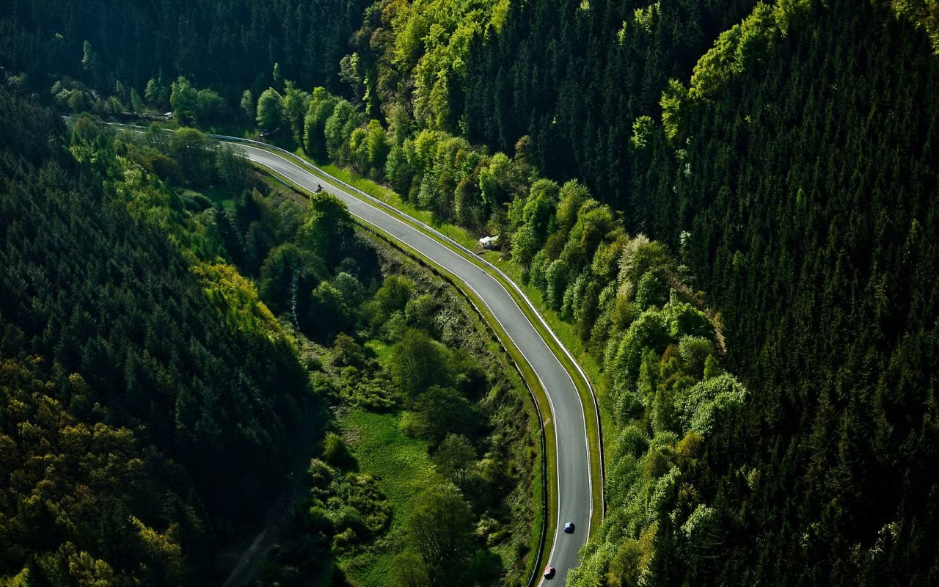
CREATED BY ENZO WÜRTELE - DATA ANALYST
Green Hell Predictor
2025
v1.0
HARNESSING DATA & AI FOR PERFORMANCE PREDICTION

Slide 2
TODAY'S
MY PLAN
DATA COLLECTION & INTEGRATION
Feature Engineering & AI Predictions
AWS UPDATING
Performance Visualisations
Key Insights & Conclusions
PITCH DECK
02
AGENDA

Slide 3
Vision
MY PLAN
To create the ultimate AI-powered performance predictor for Nürburgring lap times, blending real-world data with cutting-edge machine learning to provide accurate, data-driven insights for car enthusiasts, engineers, and racing professionals.
03

Slide 4
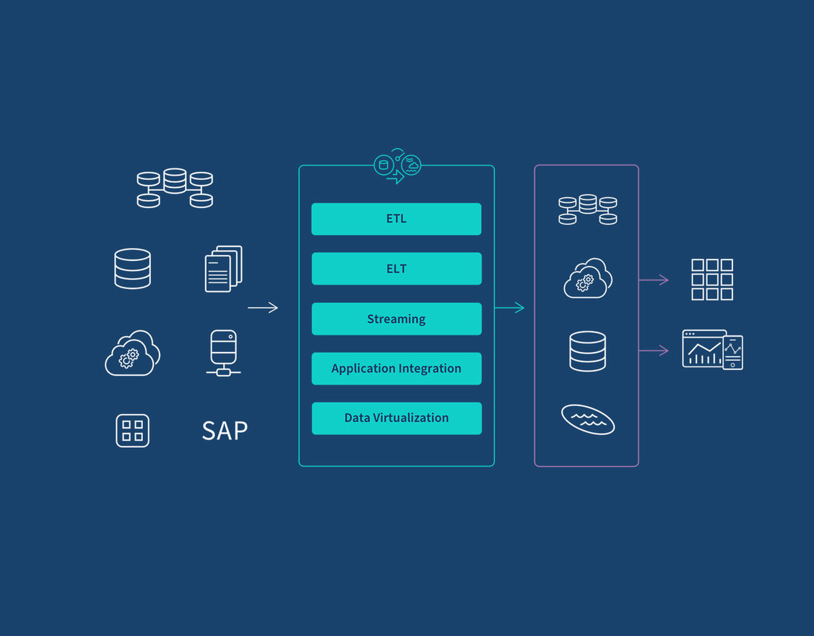
DATA COLLECTION & INTEGRATION
Scraped & stored car data in PostgreSQL.
Retrieved & processed with Pandas, handling missing values via AI.
Built a Streamlit app with Plotly for interactive performance analysis.
04

Slide 5

FEATURE ENGINEERING & AI PREDICTIONS
05
Enhanced data with power-to-weight ratios & acceleration metrics.
Used AI to predict missing values and estimate Nürburgring lap times.
Integrated insights into an interactive dashboard for performance analysis.

Slide 6

AWS UPDATING
Implemented AWS Lambda to automate data updates, ensuring the latest car performance metrics are consistently reflected in the app. This serverless approach optimises scalability, reduces costs, and enhances reliability.
06

Slide 7
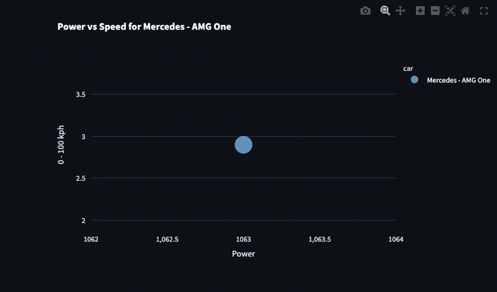
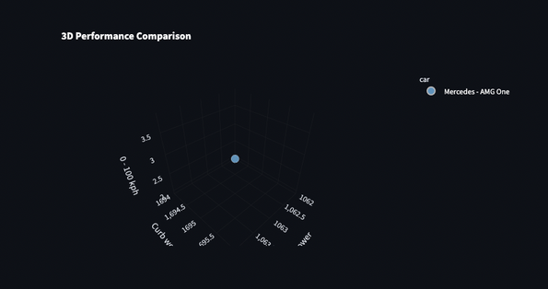
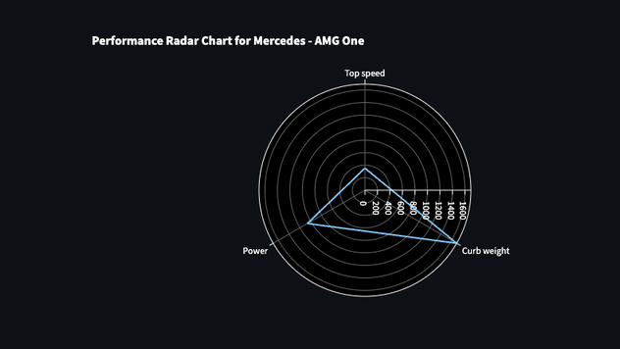
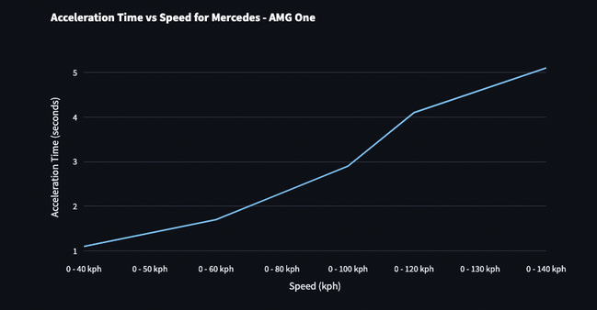
Created interactive 3D scatter plots and line graphs to analyse car performance.
Visualised key metrics like power-to-weight, acceleration, and top speed.
Gave users a dynamic way to compare and explore car specs.
07
PERFORMANCE VISUALIZATIONS

Slide 8

Challenges
Data Collection & Cleaning
Missing values in car specifications
Inconsistent data formats across sources
AI-Powered Predictions
Handling missing values dynamically using AI
Ensuring AI-generated data aligns with real-world performance
Performance Analysis & Visualisation
Correlation matrix returning NaN values
Matching Streamlit’s theme with interactive visualisations
Optimising radar chart for seamless background integration
Database & Backend Issues
Connecting Streamlit with PostgreSQL efficiently
Querying and structuring data for smooth retrieval
Optimising User Experience
Making data interactive yet simple to understand
Choosing the best visualisations for performance insights
08

Slide 9
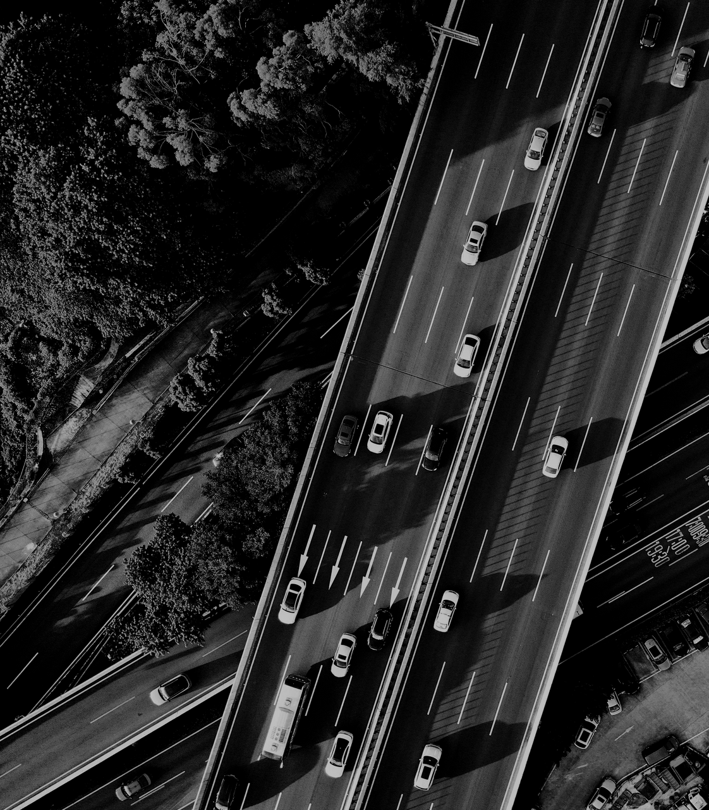
Conclusion
AI-powered predictions effectively estimate missing car specs and lap times.
Visualisations highlight performance trends across cars, revealing strengths and weaknesses.
Interactive dashboards provide users with valuable insights to compare cars and enhance decision-making.
Data-driven approach improves understanding of car performance on the Nürburgring circuit.
09

